Slide 1
Cryptography Unit 3 ‘Asymmetric Cipher’
Prepared by: Abhishek Dewan

Slide 2
Prime Numbers
An integer p > 1 is a prime number if and only if its only divisors are ± 1 and ±p.
This is known as the fundamental theorem of arithmetic. Examples are:
91 = 7 x 13 (factorization)
3600 = 24 x 32 x 52
11011 = 7 x 112 x 13

Slide 3
Application:
Prime numbers are used in cryptography because they are difficult to factorize. This means that it is difficult to find the prime factors.
This makes it difficult for someone to intercept a message and read it without the proper key, since the key constitutes the prime numbers.

Slide 4
A hacker or thief attempting to crack a 400-digit encryption code that obscures your credit card details, with a computer that tests 1 million combinations per second, would take around 10 raised to the power 194 seconds to accomplish the feat.
The Universe is 10 raised to the power 18 seconds old.

Slide 5
Let’s say that C is a product of two prime numbers P and Q.
While encrypting, say, your credit card details, the number C is used to generate the “public” key.
This key, as its name suggests, is available to the public, meaning that it can be intercepted and read by anyone in the network.
Banks are known to use public keys that are 617 digits long to secure your private transactions.

Slide 6
The private key constitutes the two prime numbers P and Q, which were multiplied to produce C, the public key.
Without their knowledge, someone, to peek in, must factorize C, which could take thousands of years if the numbers are hundreds of digits long.
There are a lot of huge prime numbers.
The largest found prime number is 2 raised to the power 43,112,609 subtracted by 1 whose primality was verified by a computer.

Slide 7
If you were to write this number on an A4-size paper, it would take you a total of 4376 papers, yes, a tremendously thick stack of 4,376 papers, to complete the sequence.
Lastly, factorization is not impossible; it can be done.
It is just exorbitantly time-consuming.

Slide 8
The largest numbers a computer drudgingly factorized into their primes were, 2 raised to the power 512 and recently, 2 raised to the power 768-digit long.
Messages are encrypted by 2 raised to the power 1024-digit long public keys, some even by a 2 raised to the power 2048-digit long public key.

Slide 9
Testing for Primality
Fermat’s Theorem
Fermat's theorem states the following:
If p is prime and a is a positive integer not divisible by p, then a^{p-1}=1 (mod p) (here a and p are relatively prime)
Alternative form of fermat theorem is: a^{p}=a(mod p)

Slide 10
Simple Example:
For a = 2, p =7
Calculating,
a^{p-1}=1 (mod p)
2⁷⁻¹ (mod 7)
2⁶ (mod 7)
64 (mod 7)
1 (mod 7)
Calculating, a^{p}=a (mod p)
2⁷ (mod 7)
128 (mod 7)
Or, [2³ . 2³. 2¹] (mod 7)
1.1.2 (mod 7)
2 (mod 7)

Slide 11
??? Using Fermat’s Theorem, compute the following:
2²⁴⁵ (mod 11)

Slide 12
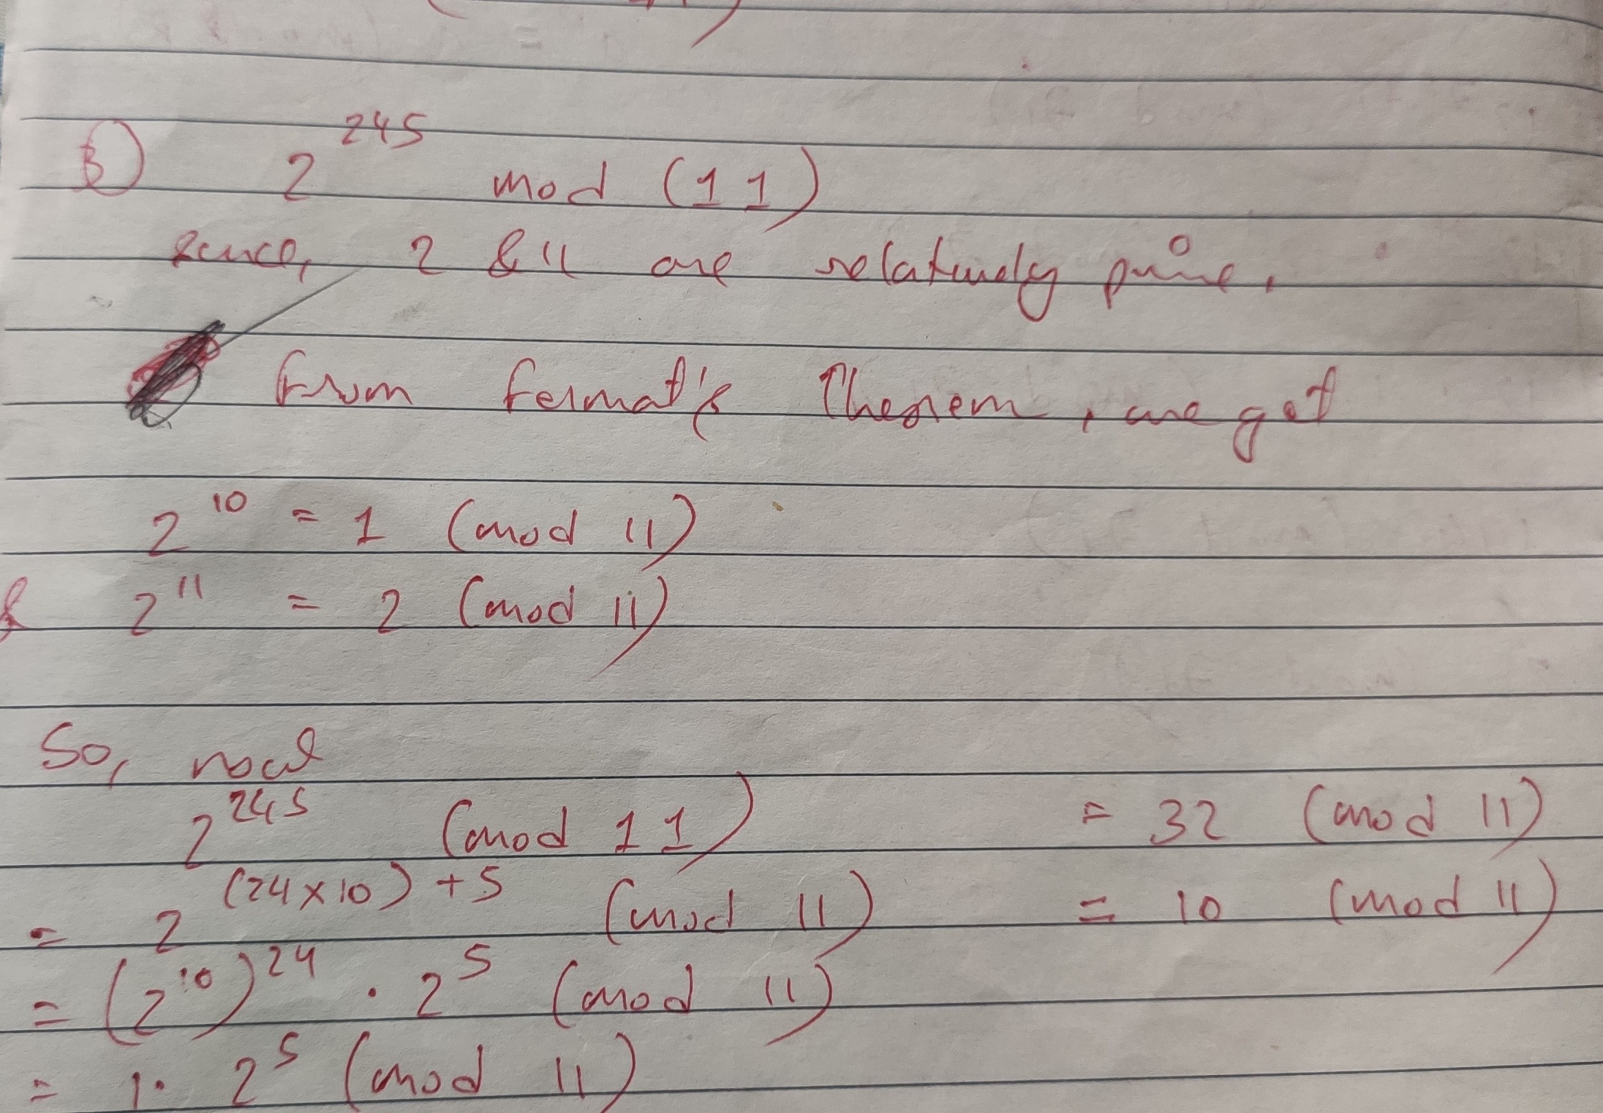

Slide 13
??? Using Fermat’s Theorem, compute the following:
12⁷⁷² (mod 71) (Solve by using both form)
5¹³¹ (mod 41)

Slide 14
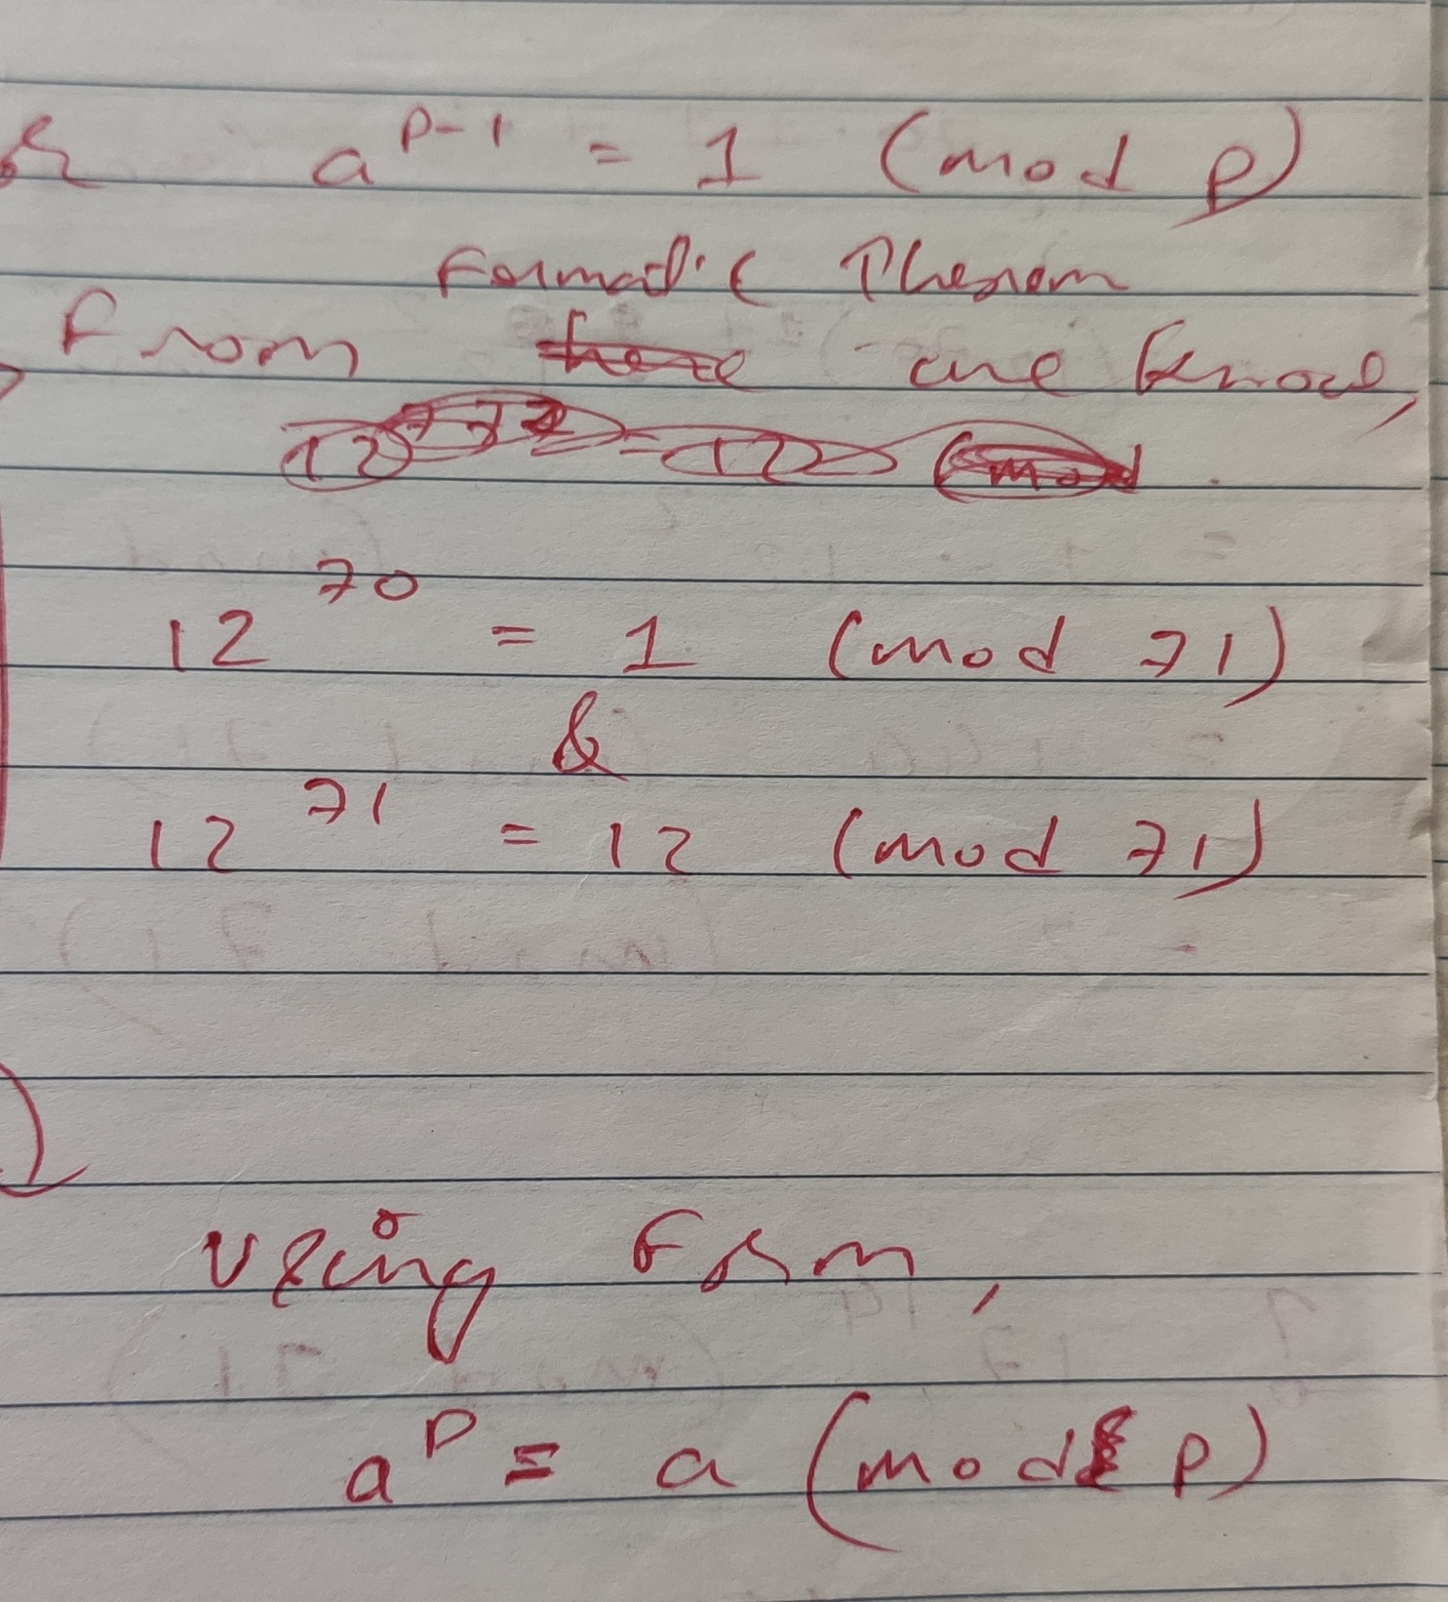

Slide 15
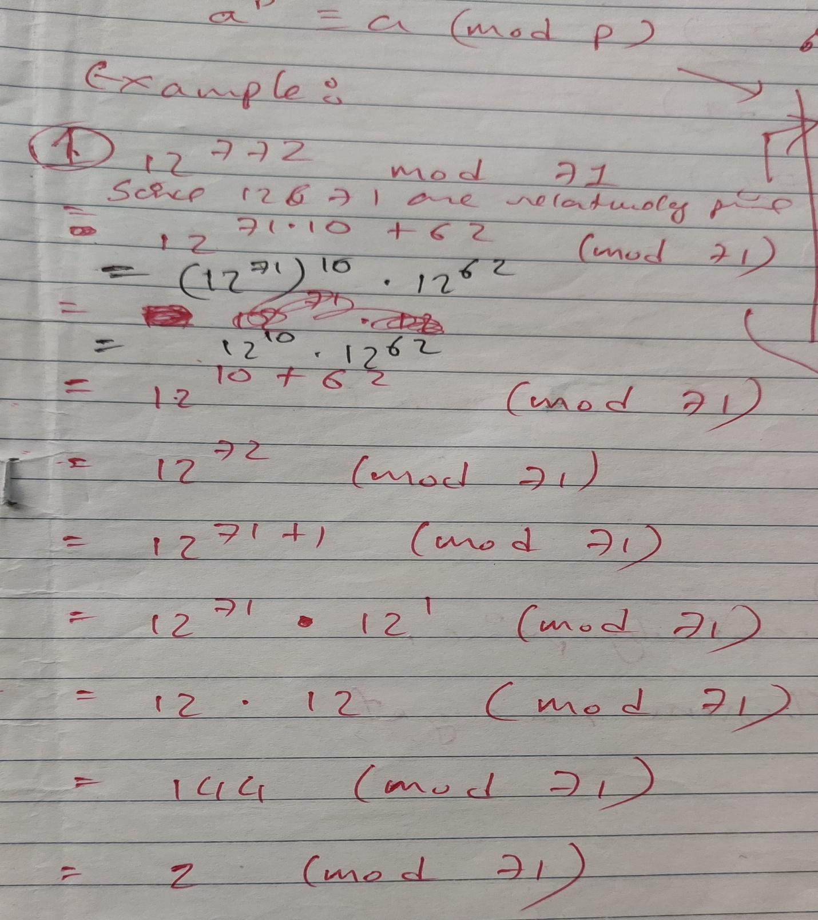

Slide 16
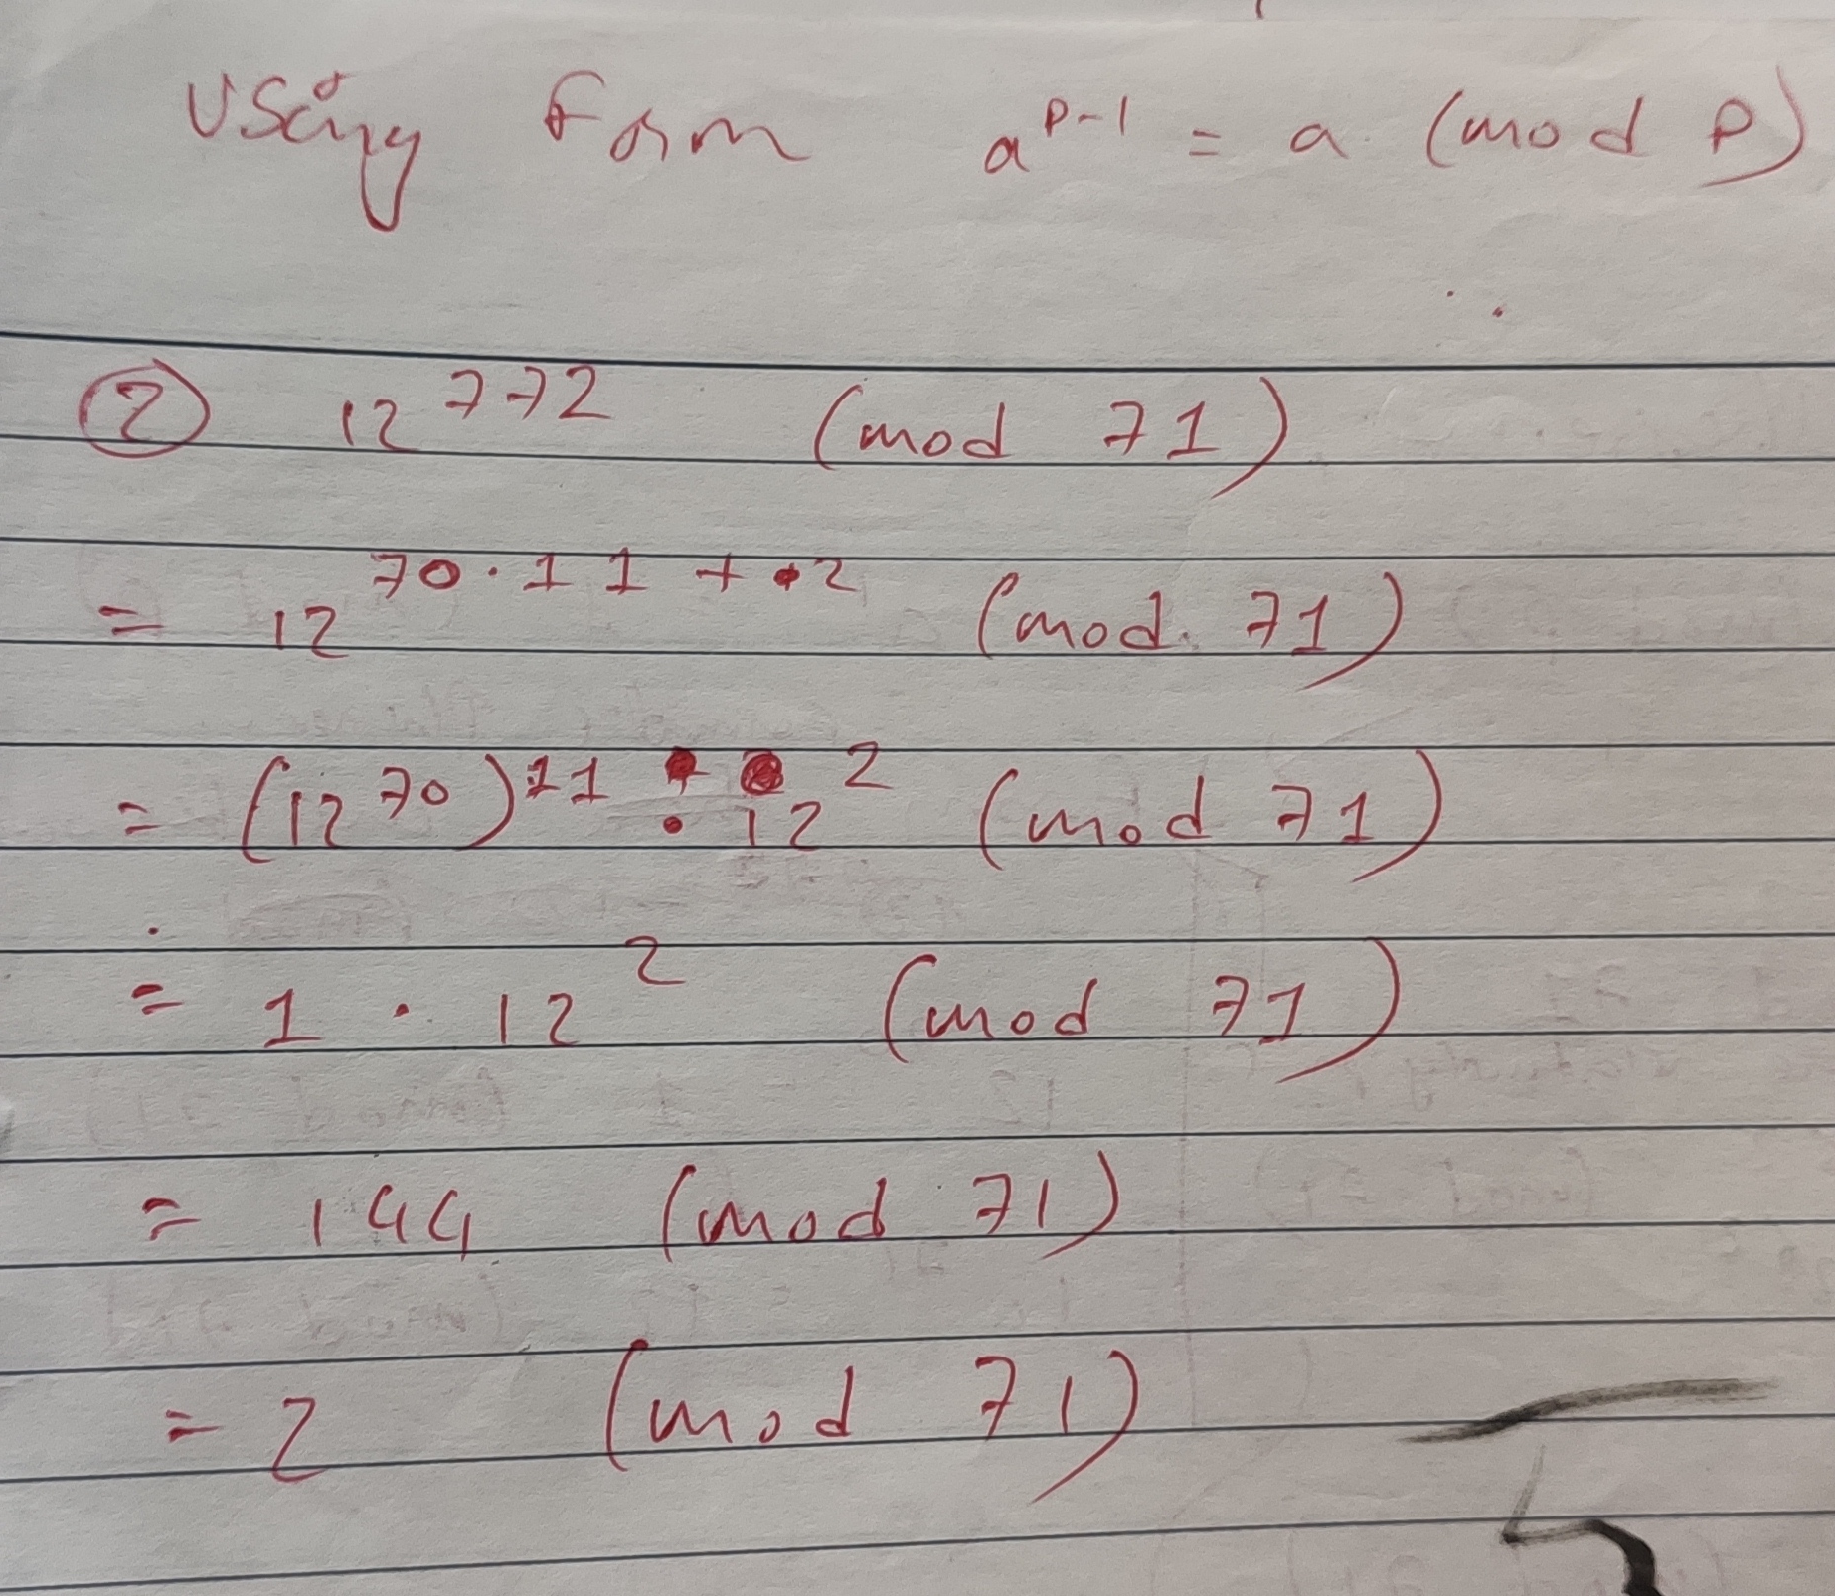

Slide 17
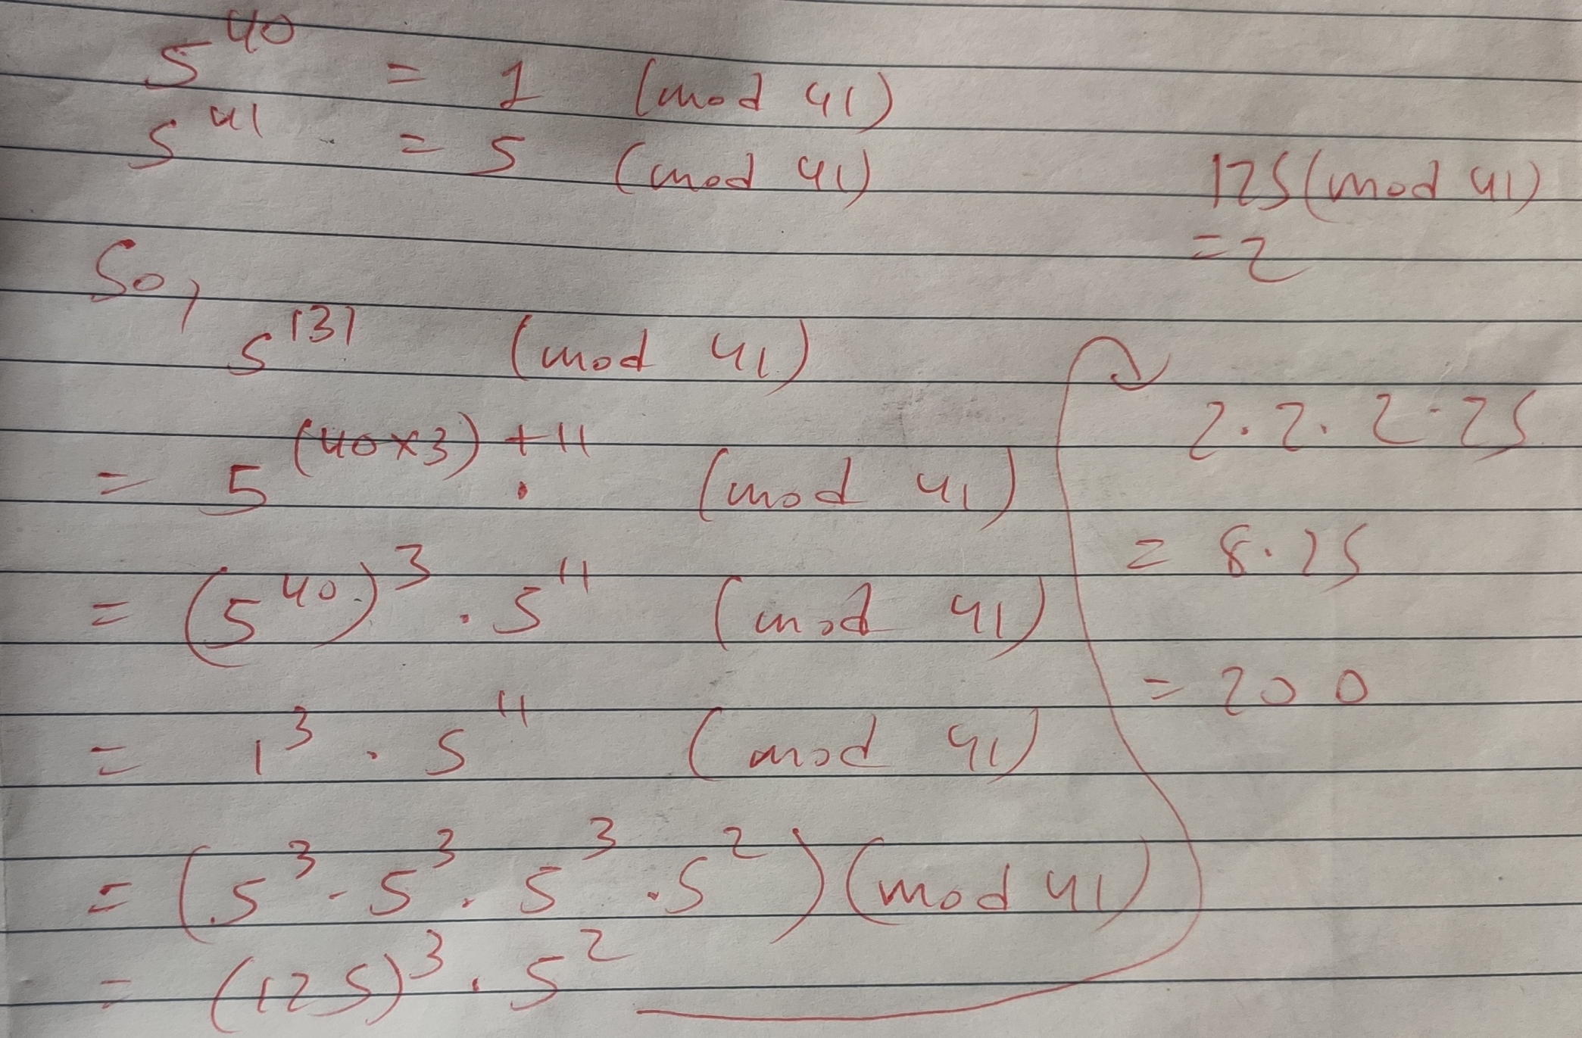
=36 (mod 41)

Slide 18
??? Using Fermat’s Theorem, compute the following:
2²⁰⁴⁷⁴²³⁰²³ (mod 11)

Slide 19
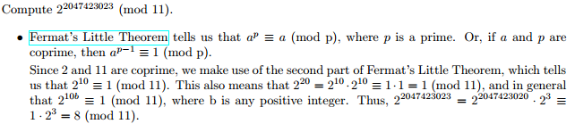

Slide 20
Miller-Rabin Algorithm
The algorithm due to Miller and Rabin is typically used to test a large number for primality.
Before explaining the algorithm, we need some background.

Slide 21
First, any positive odd integer n>= 3 can be expressed as follows: n - 1 = 2^{k}.q with k > 0, q odd

Slide 22
Two Properties of Prime Numbers
The first property is stated as follows:
If p is prime and a is a positive integer less than p, then a² mod p = 1 if and only if either a mod p = 1 or a mod p= 1
The second property is stated as follows:
Let p be a prime number greater than 2. We can then write p -1 = 2^{k}q, with k > 0 q odd.
Let a be any integer in the range 1 < a < p 1.

Slide 23
Miller-Rabin Algorithm 1. Find integers k, q, with k > 0, q odd, so that n-1 = 2^{k}q;
2. Select a random integer a, 1 < a < n-1;
3. if a^{q} mod n = 1 then return("inconclusive / maybe prime ");
4. for j = 0 to k - 1 do
5. if a² mod n = n - 1 then return("inconclusive / maybe prime");
Else return("composite");

Slide 24
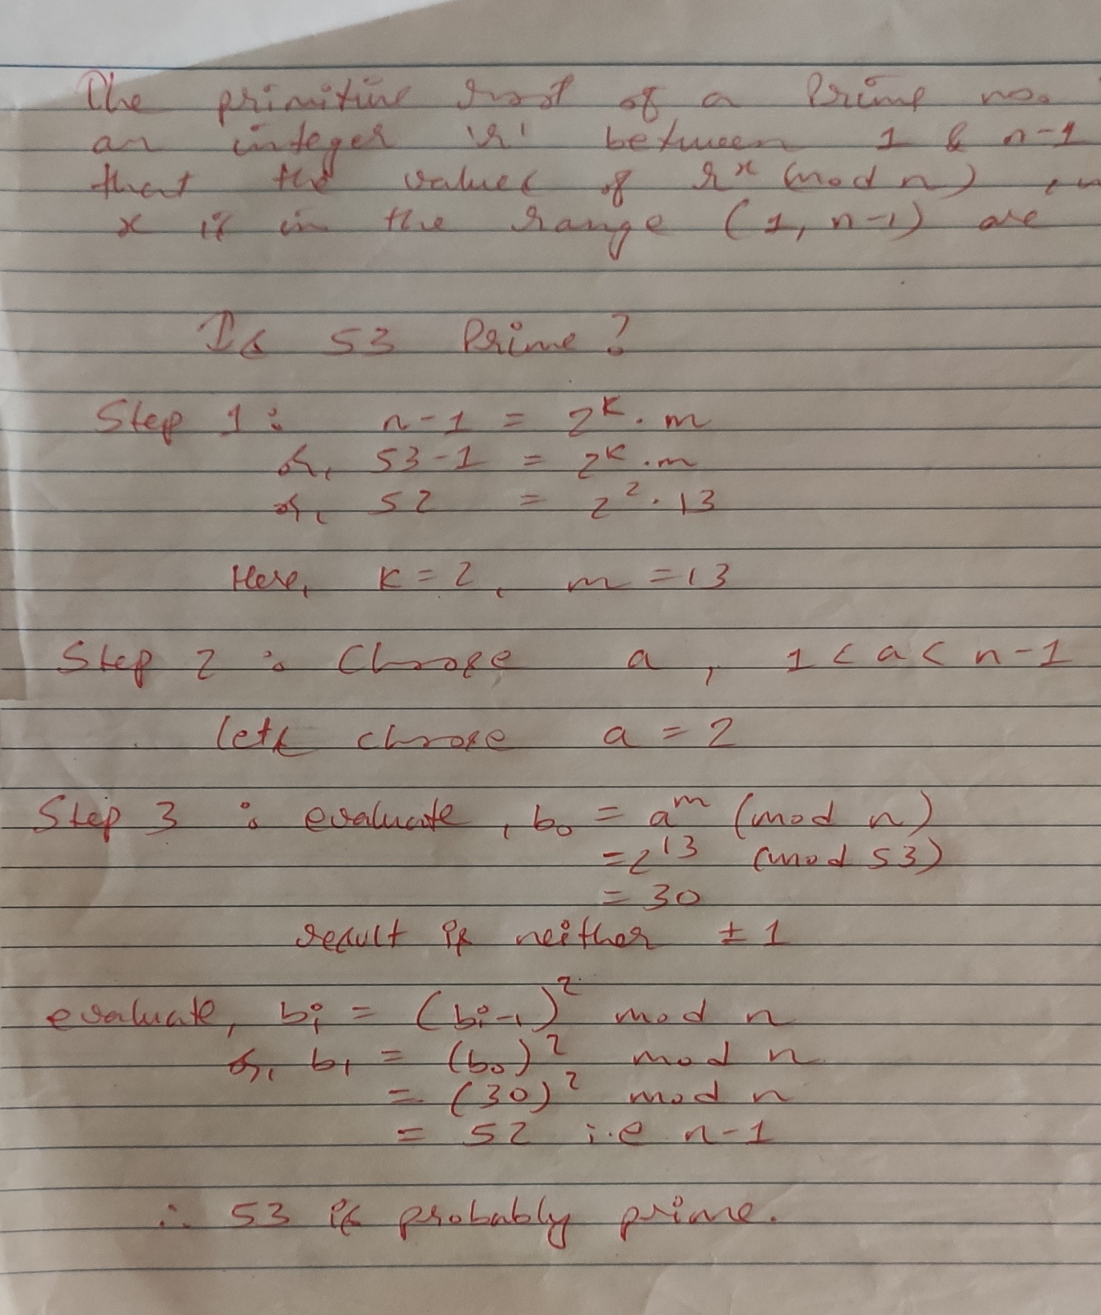

Slide 25
Is 1729 Prime?
Is 1651 Prime?
Is 151 Prime?
Is 739 Prime?

Slide 26
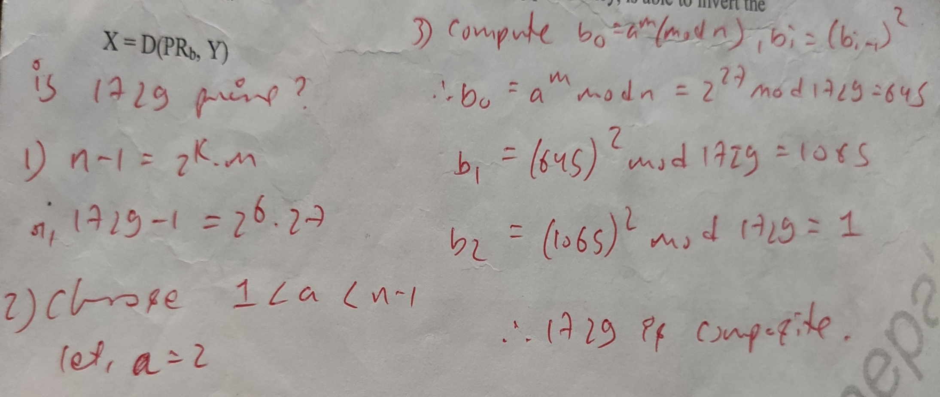

Slide 27
Euler's Totient Function
in number theory, referred to as Euler's totient function written φ(n), is defined as the number of positive integers less than n and relatively prime to n.
By convention, φ(1) = 1.

Slide 28
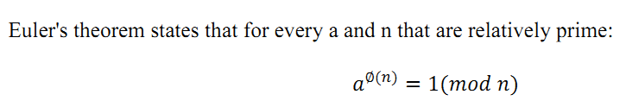
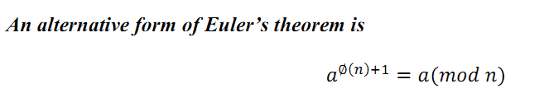
If n is prime number then φ(n)=n-1.
Euler’s Theorem

Slide 29
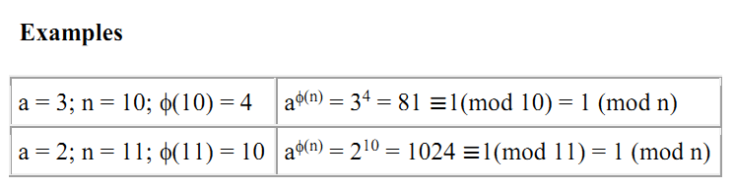

Slide 30
Example:
Φ(14)
Here, numbers less than 14 = 1,2,3,……..,13
We see,
14 and numbers 2,4,6,8,10,12 have common factors i.e. 2
&14 and numbers 1,3,5,9,11,13 don’t have common factors Therefore, Φ(14) = 6

Slide 31
Evaluate: φ(20) & φ(13)
And prove Euler’s theorem.

Slide 32
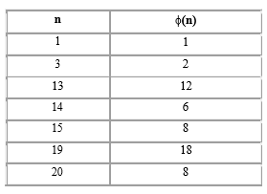

Slide 33
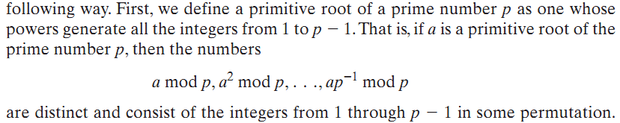
Primitive roots

Slide 34
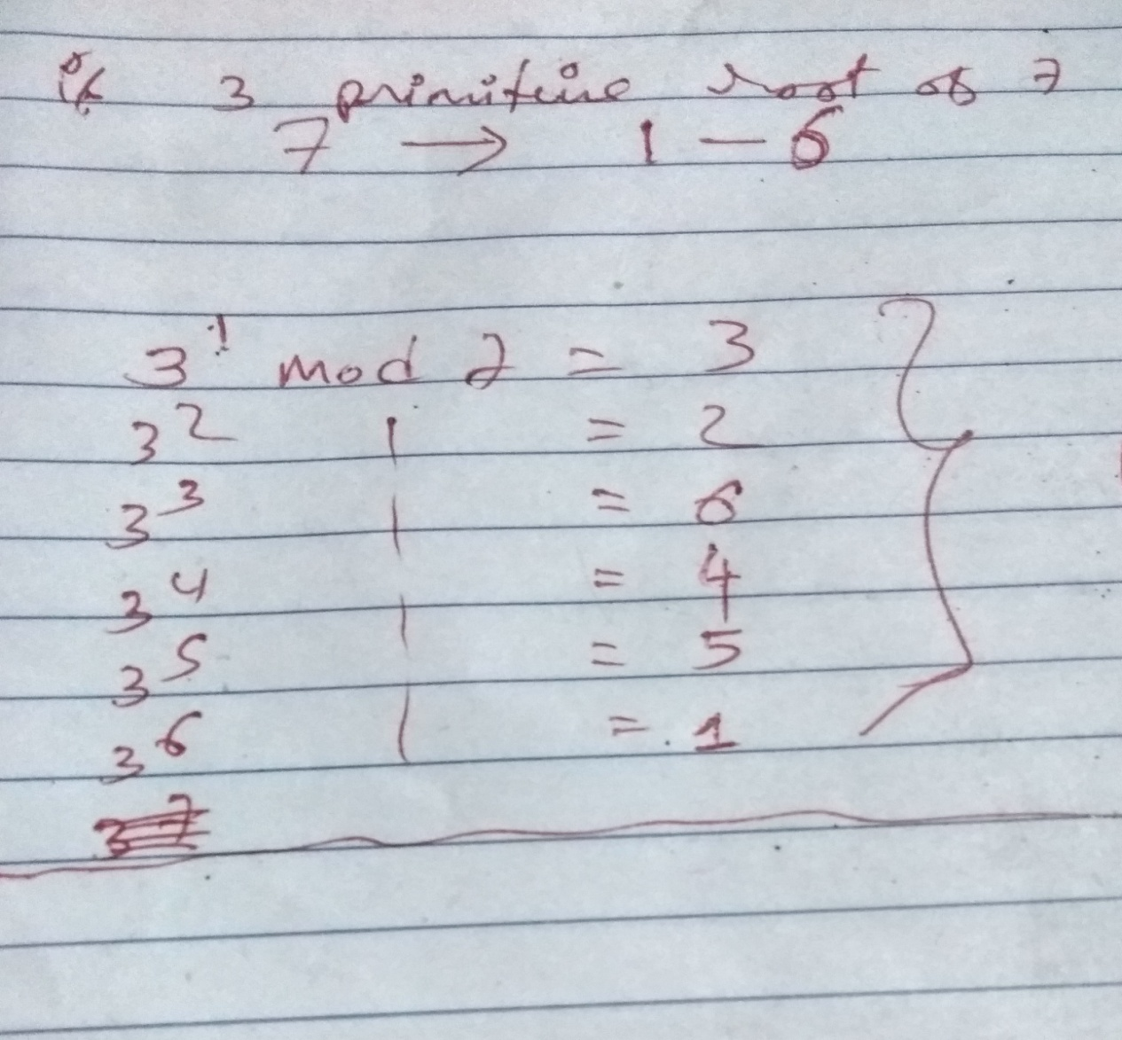
Calculating Primitive roots (TU 2072)
Since, all the values are unique. 3 is a primitive root of 7.

Slide 35
Is 2 primitive root of 13?
Is 4 primitive root of 7?

Slide 36
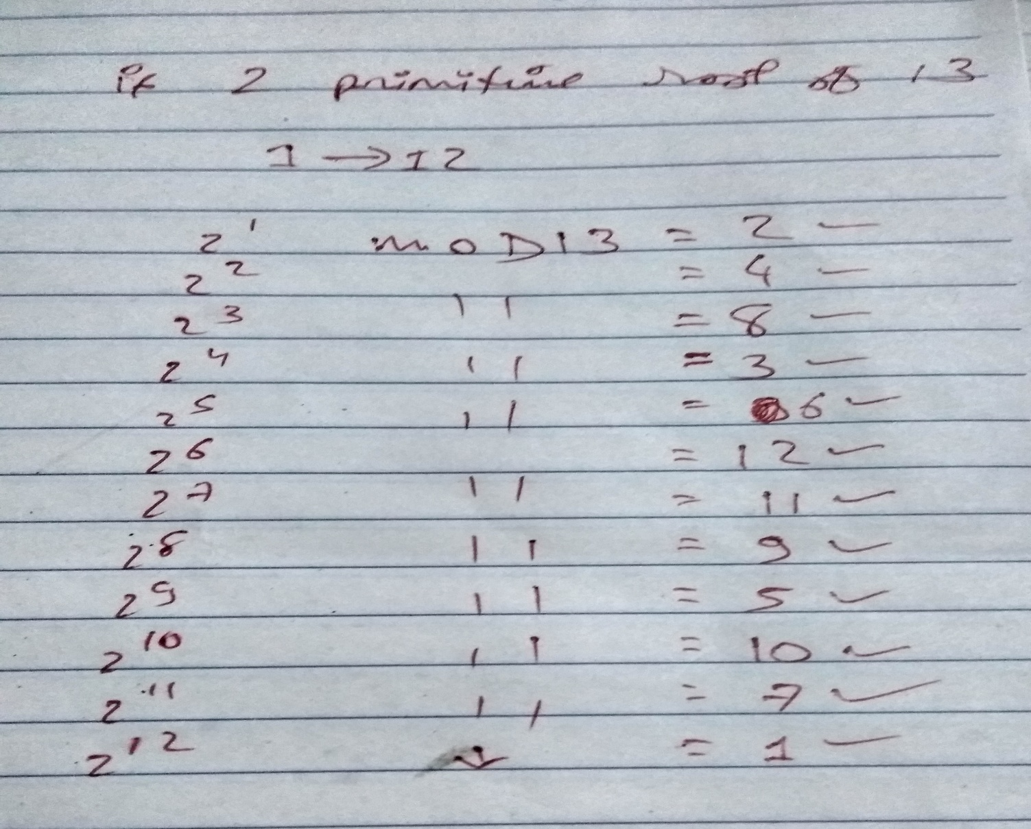
One more example

Slide 37
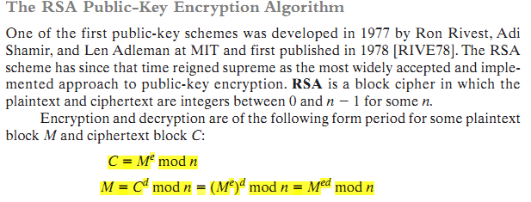
RSA Algorithm

Slide 38
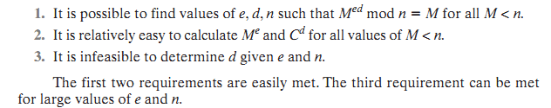

Slide 39
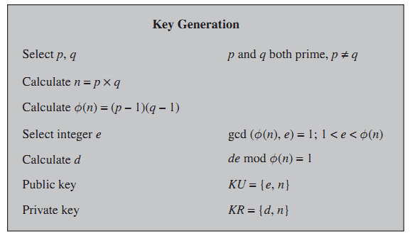
Key Generation

Slide 40
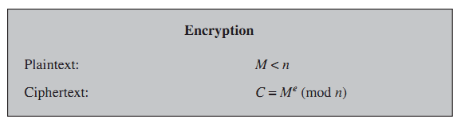
Encryption
*Note: don’t choose too small primes like p=2 & q=3, as it gives product < 26 which will not accommodate all the alphabets while decrypting. (since, we have to perform mod n while decrypting)

Slide 41
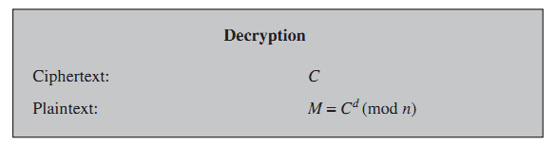
Decryption

Slide 42
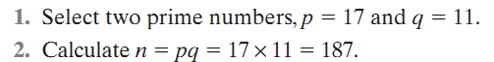
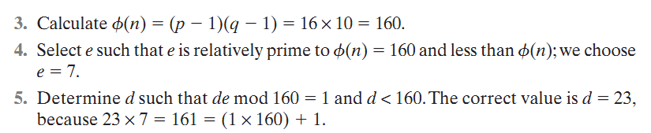
Worked Out Example
This gives Public key (e,n) i.e. (7,187) and Private key (d,n) i.e. (23, 187)

Slide 43
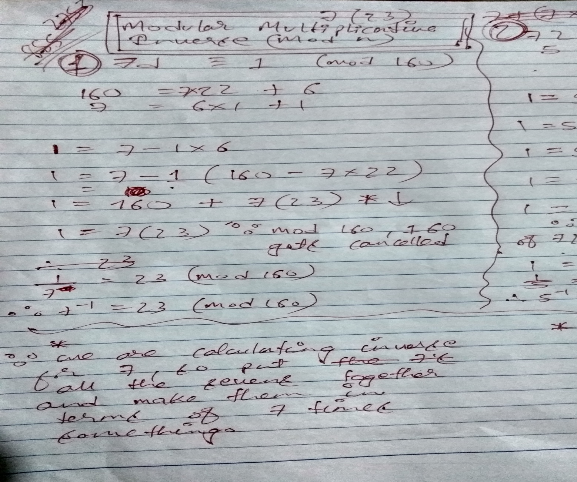
Calculating Multiplicative inverse using EXTENDED EUCLIDEAN ALGORITHM

Slide 44
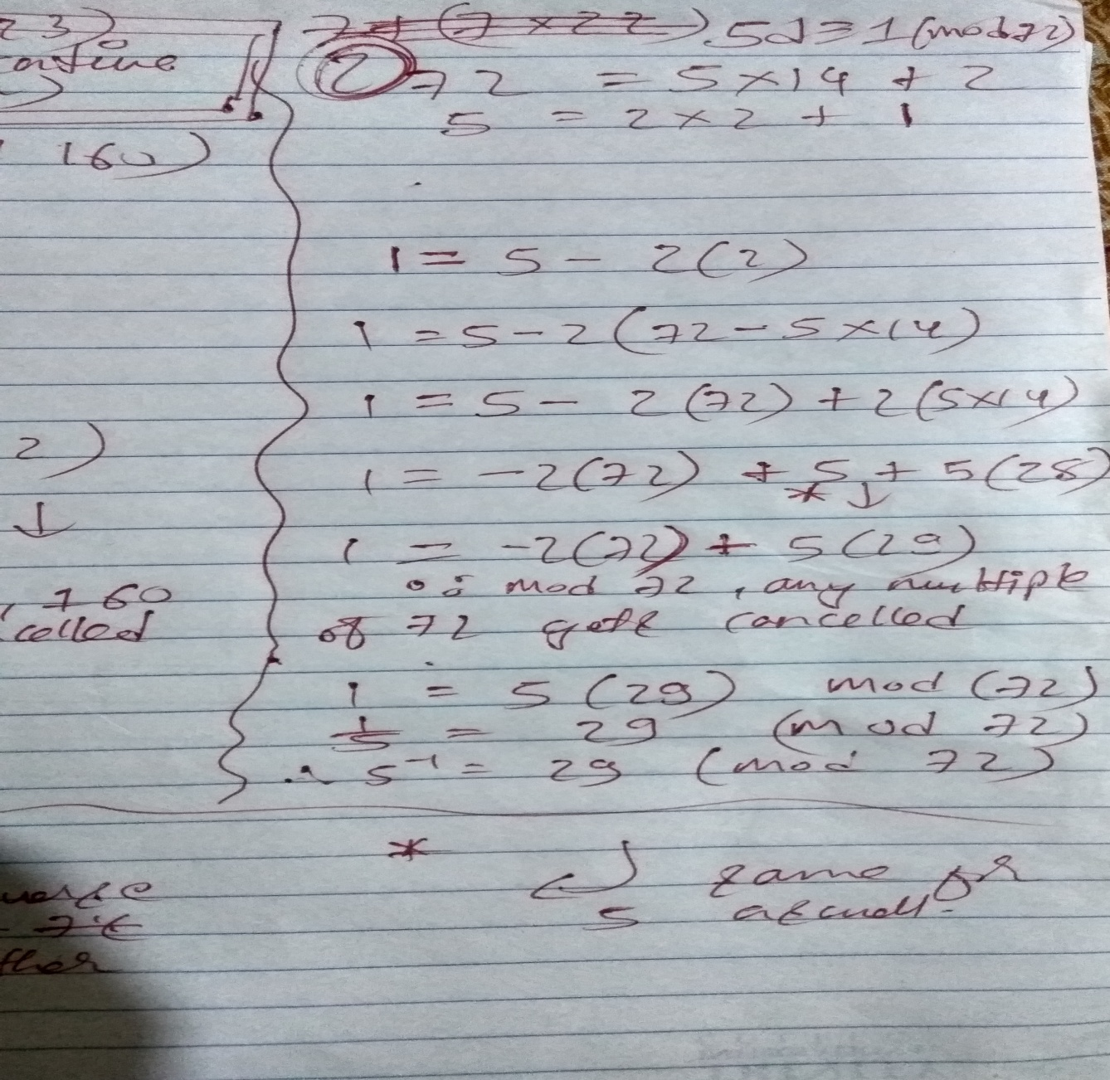
One more example using EEA

Slide 45
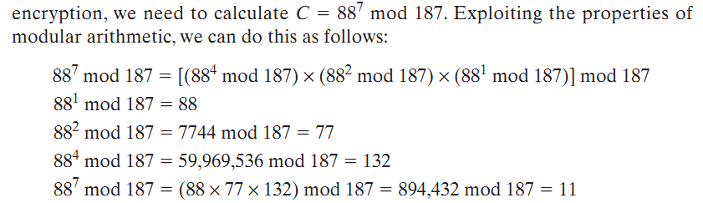
W.O.E Encryption

Slide 46
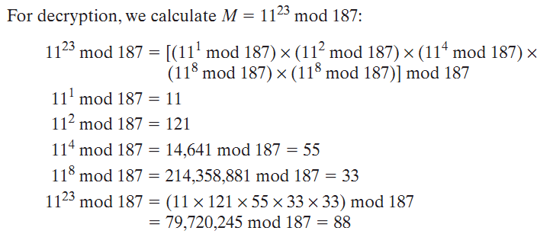
W.O.E Decryption

Slide 47
Example 1:
This example shows how we can encrypt plaintext 9 using the RSA public-key encryption algorithm.
This example uses prime numbers 7 and 11 to generate the public and private keys.

Slide 48
Step 1: Select two large prime numbers, p, and q. Here,
p = 7
q = 11
Step 2: Multiply these numbers to find n = p x q
n = p x q
n = 7 x 11
n = 77

Slide 49
Step 3: calculate φ (n) = (p - 1) x (q-1)
φ (n) = (7 - 1) x (11 - 1)
φ (n) = 6 x 10
φ (n) = 60
Step 4: Choose a number e less that n, such that n is relatively prime to (p - 1) x (q -1)
Let us now choose relative prime e of 60 as 7.
Thus the public key is <e, n> = (7, 77)

Slide 50
Step 5: The private key is <d, n>. To determine the private key, we use the following:
7d mod 60 = 1, which gives d = 43
The private key is <d, n> = (43, 77)

Slide 51
Encryption
Step 6: A plaintext message m is encrypted using public key <e, n>.
C = m^{e} mod n
C = 9⁷ mod 77
C = 37

Slide 52
Dercryption
A ciphertext message c is decrypted using private key <d, n>.
m = c^{d} mod n
m = 37⁴³ mod 77
m = 9

Slide 53
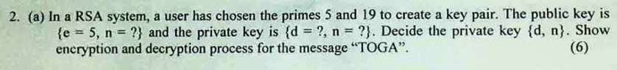
Worked Out Example (TU 2072)

Slide 54
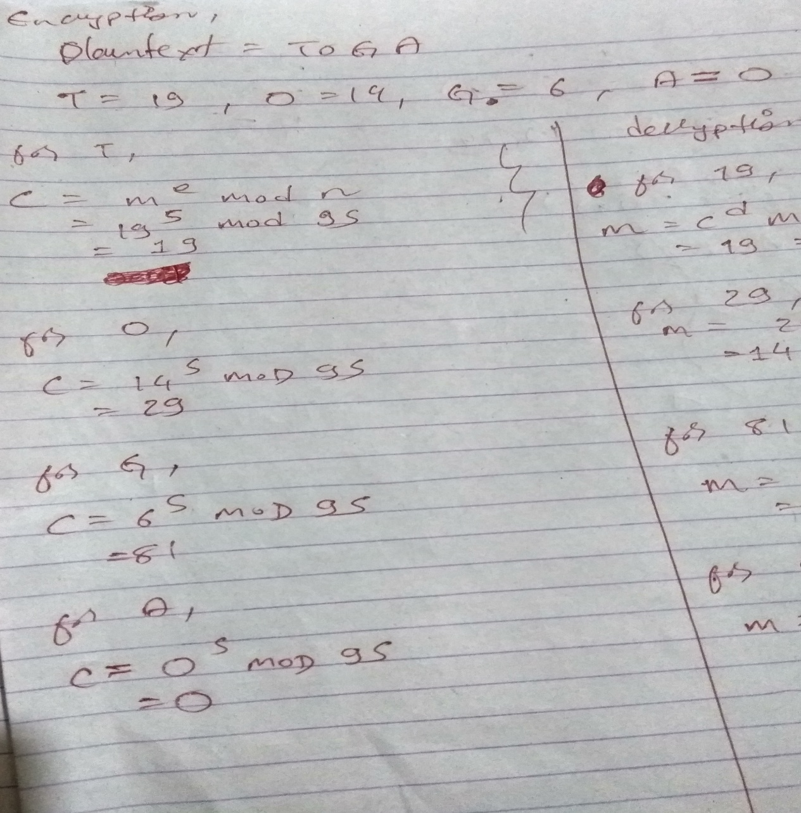
Solution Plain Text Encryption (TU 2072)

Slide 55
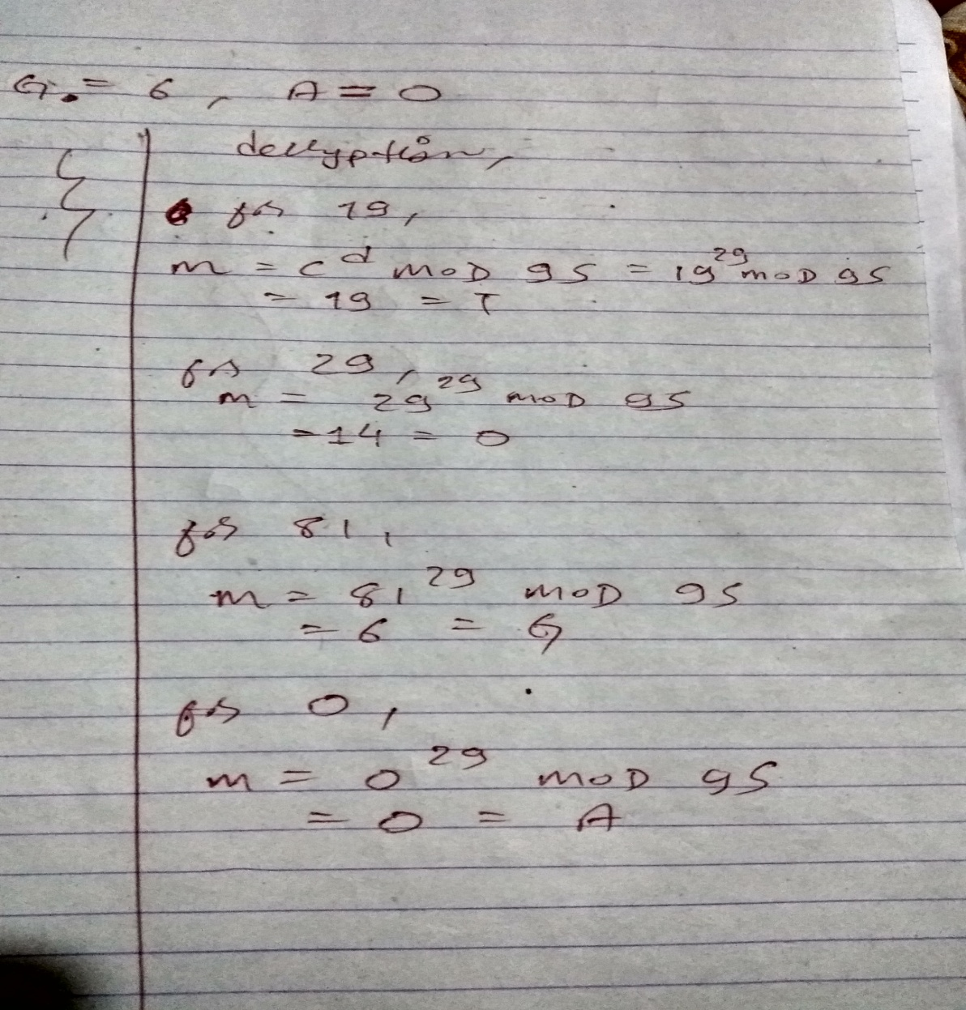
Plain Text Decryption

Slide 56
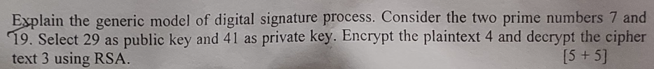
???TU 2078

Slide 57
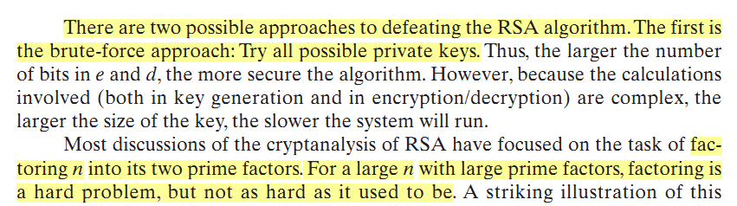

Slide 58
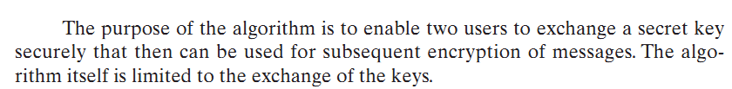
Diffie-Hellman Key Exchange Algorithm
The Diffie–Hellman (DH) Algorithm is a key-exchange protocol that enables two parties communicating over public channel to establish a mutual secret without it being transmitted over the Internet.

Slide 59
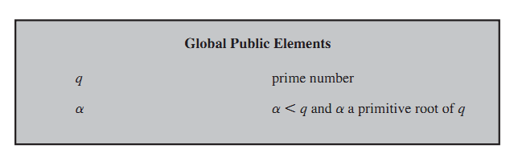
Elements of D-H Algorithm

Slide 60
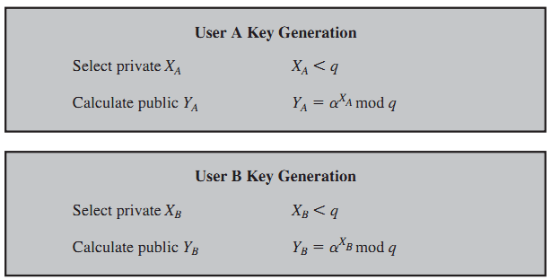
Key Generation

Slide 61
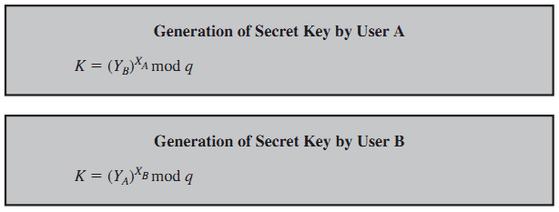

Slide 62
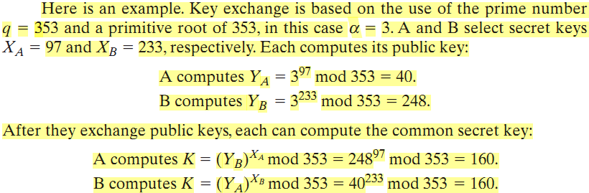
Example of key exchange

Slide 63
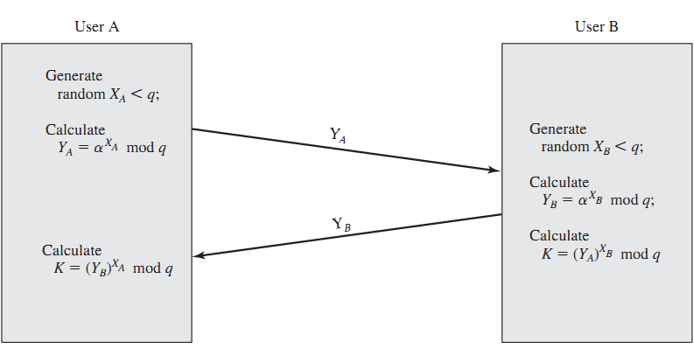
Key Exchange Process

Slide 64
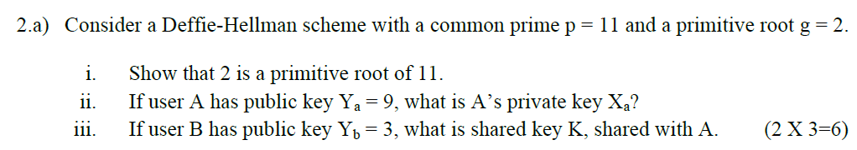
(TU 2069)

Slide 65
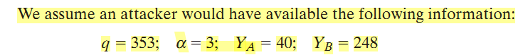
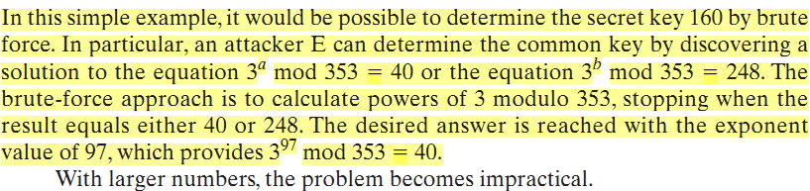
Probable Attack

Slide 66
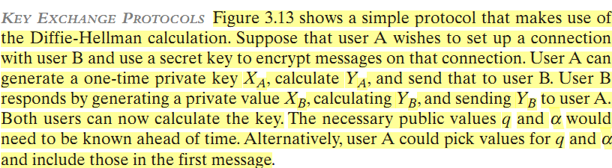
Key Exchange Protocols

Slide 67
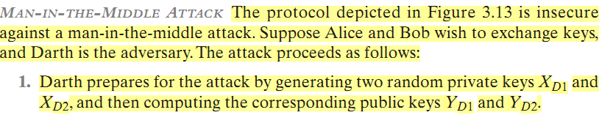
Man In the Middle Attack

Slide 68
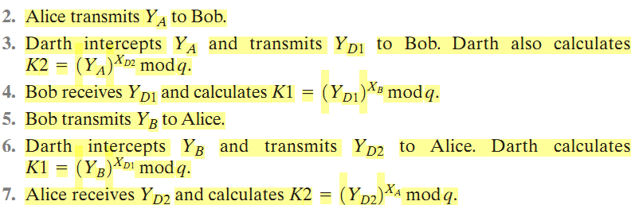

Slide 69
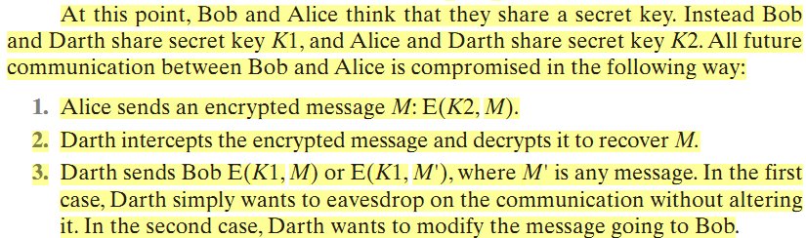

Slide 71
End of Unit ‘3’

